Slide 1
UNIVERSITY OF HARGEISA
Course: Computer Programming I (Java)
Lecture Two
Presented by:
Sahardiid Ahmed Ali

Slide 2
Chapter 1
Introduction to Java

Slide 3
Learning Objectives
At the end of the lesson student should be able to:-
Install JDK and NetBeans
Check Installed JDK Files
Apply Java Structure Code
Explain Java Statements
How to Write Comments in Java

Slide 4
Installing of JDK Setup
Open My Computer
Go to C partation
Go Program Files
Go to Java File jdk1.6.0_07
Go to Bin
Then we will get the necessary files which was discussed before.
Javac.exe
Java.exe
Appletviewer.exe

Slide 5
How to use JDK Directly
Intall JDK then wait until the process will finish
Copy the path (C:\Program Files\Java\jdk1.6.0_07\bin)
Go to Mycomputer
Click right
Select the Properties
Select the Advanced System
Environment Variables
Select the Path
Select Edit
Select Edit Text

Slide 6
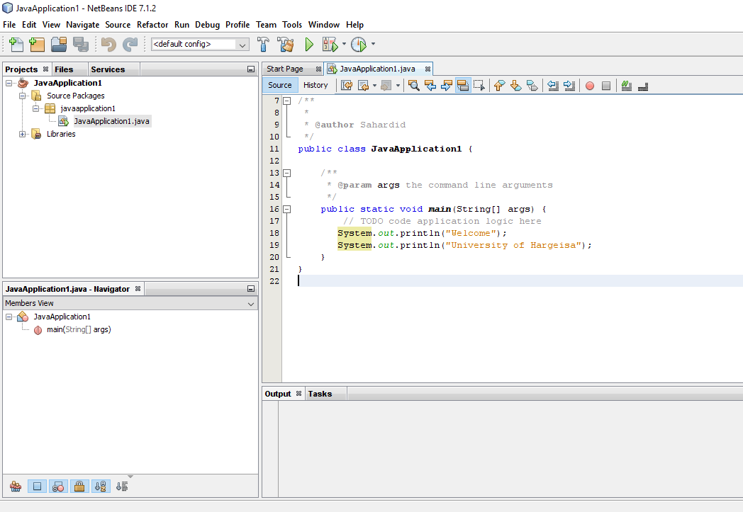
How to Install NetBeans
Install the NetBeans wait until the process will finish

Slide 7
Structure of Java Code
public class Hello {
public static void main(String[] args) {
Statements;
}
}
Note:-
Name of Class must be same Name of File

Slide 8
Java Comments
Single-line Comment:
It starts with a pair of forwarding slash (//).
For example:
//First Java Program
Multi-line Comment:
It starts with a /* and ends with */. We write between these two symbols.
For example:
/*It is an example of
multiline comment*/

Slide 9
Java Example
public class Hello {
public static void main(String[] args) {
System.out.println("Welcome");
System.out.println("University of Hargeisa");
}
}

Slide 10
How to use directly JDK
Go to Start button
Go to run
Write cmd then enter
Go to Hello.java file the cut the file
Go to C partation then past it
write the fallowing commands
cd.. then enter
cd.. then enter
cls then enter
javac Hello.java then imidiately shows Hello.class
java Hello then enter it shows results

Slide 11
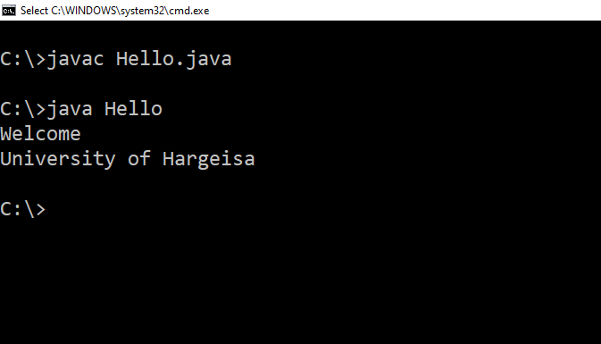
Results look like this

Slide 12

Any Question??

Slide 13
Thanks

